Slide 1


Slide 2
What Is Hardware In The Loop Testing?
?

Slide 3
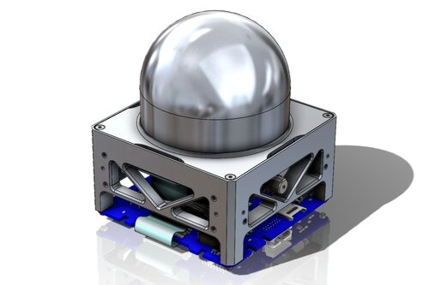
What Is Hardware In The Loop Testing?

Slide 4
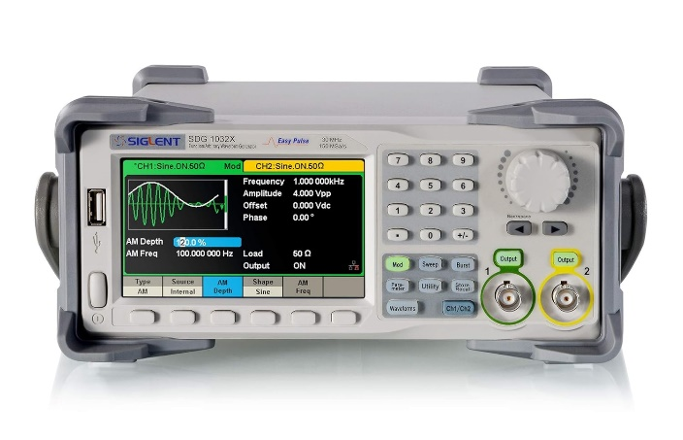
What Is Hardware In The Loop Testing?

Slide 5

What Is Hardware In The Loop Testing?

Slide 6
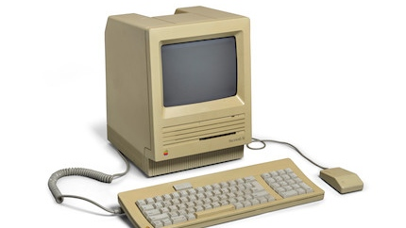
What Is Hardware In The Loop Testing?
?

Slide 7
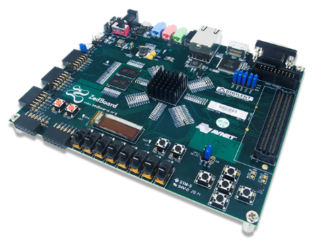
What Is Hardware In The Loop Testing?

Slide 8
So What’s The Problem?
Those with the expertise to test the system rarely know how to write good code
Programmers rarely dabble in radiation physics
So this testing process would have a lot of back and forth

Slide 9
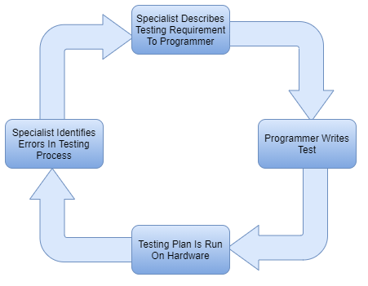
HIL Process Flow

Slide 10
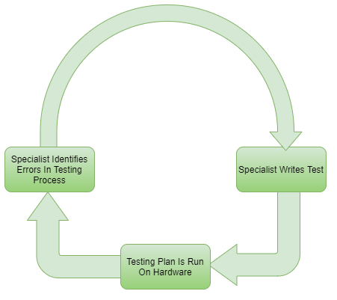
HIL Process Flow

Slide 11
Enter Domain Specific Languages
Let’s make a DSL that write’s like a test plan
The DSL can then generate C code automatically
Now the domain specialists don’t need to write complex code!

Slide 12
What Would An HIL DSL Look Like?
Drive Inputs
Record Outputs
Acceptance Criteria
Signal Comparison
Test Outputs
David Thonnessen, Hardware-in-the-Loop Testing of Industrial Automation Systems Using PLC Languages
Thonnessen & Reinker, A Concept for PLC Hardware-in-the-loop Testing Using an Extension of Structured Text

Slide 13
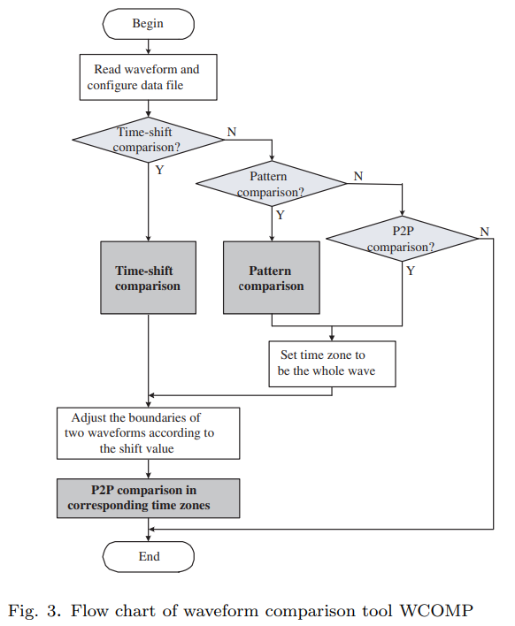
Signal Comparison: Related Work
WCOMP: Waveform Comparison Tool for Mixed-signal Validation Regression in Memory Design
Proposed 3 comparison algorithms
These algorithms are all for PWM-like pulse comparisons

Slide 14
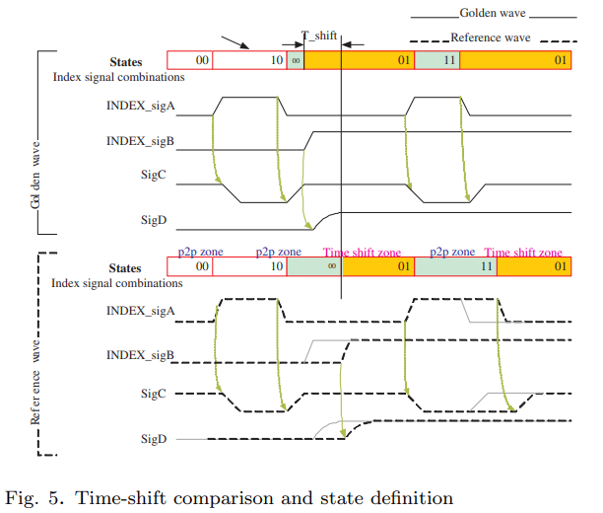
Signal Comparison: Related Work

Slide 15
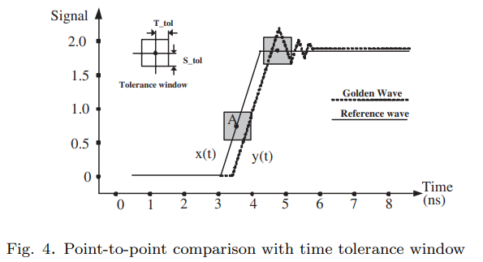
Signal Comparison: Related Work

Slide 16
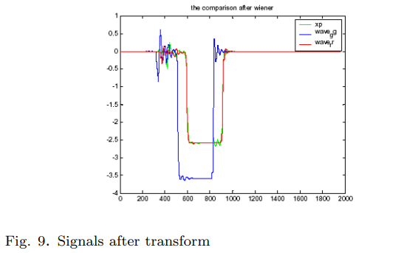
Signal Comparison: Related Work
(For Pattern Comparison Algorithm)

Slide 17
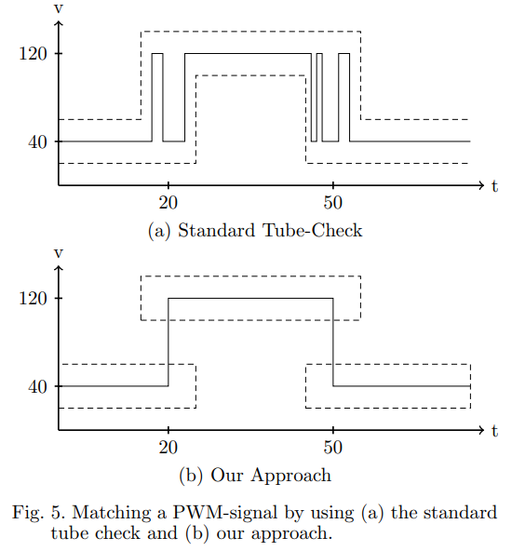
Signal Comparison: Related Work
Matching Discrete Signals for Hardware-in-the-Loop-Testing of PLCs
Proposed Set-Match
An algorithm for matching discrete signals without the downfalls of P2P

Slide 18
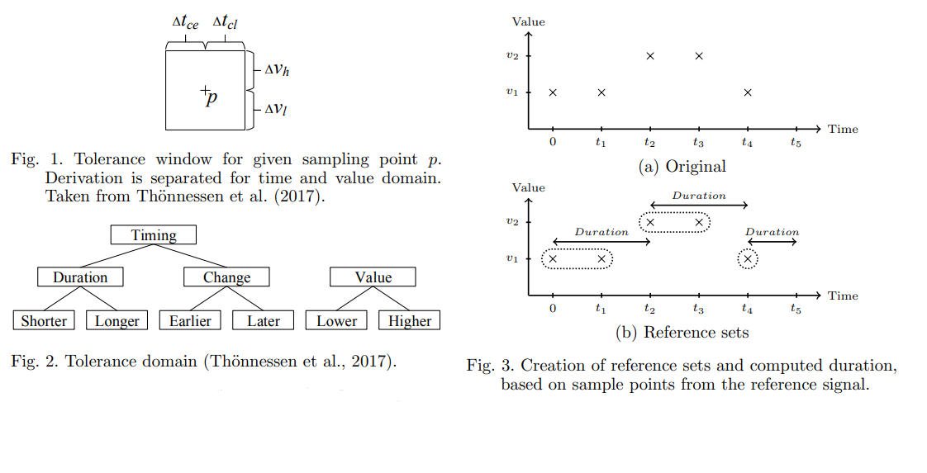
Signal Comparison: Related Work

Slide 19
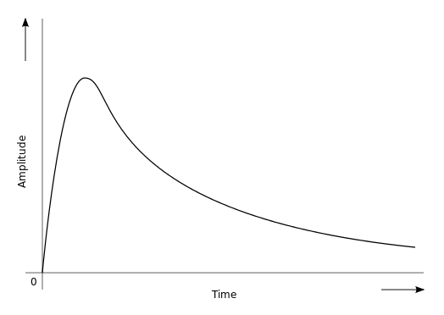
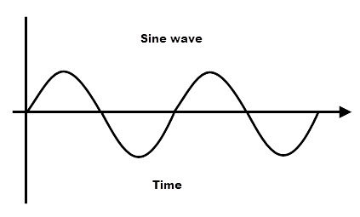
What’s Missing?
All these papers compare digital or close-to-digital signals
On some boards, we have fully analog signals:
Sine Waves
Exponential Pulses

Slide 20
How Can We Match Analog Signals
Ideally with a binary matching algorithm
This is usually unrealistic
So what options do we have?
The algorithms discussed in previous works (pipe, rtol, etc…)
Basic error measurements (mse, rmse, mae)
Distance Measurements (Euclid, Frechet)

Slide 21
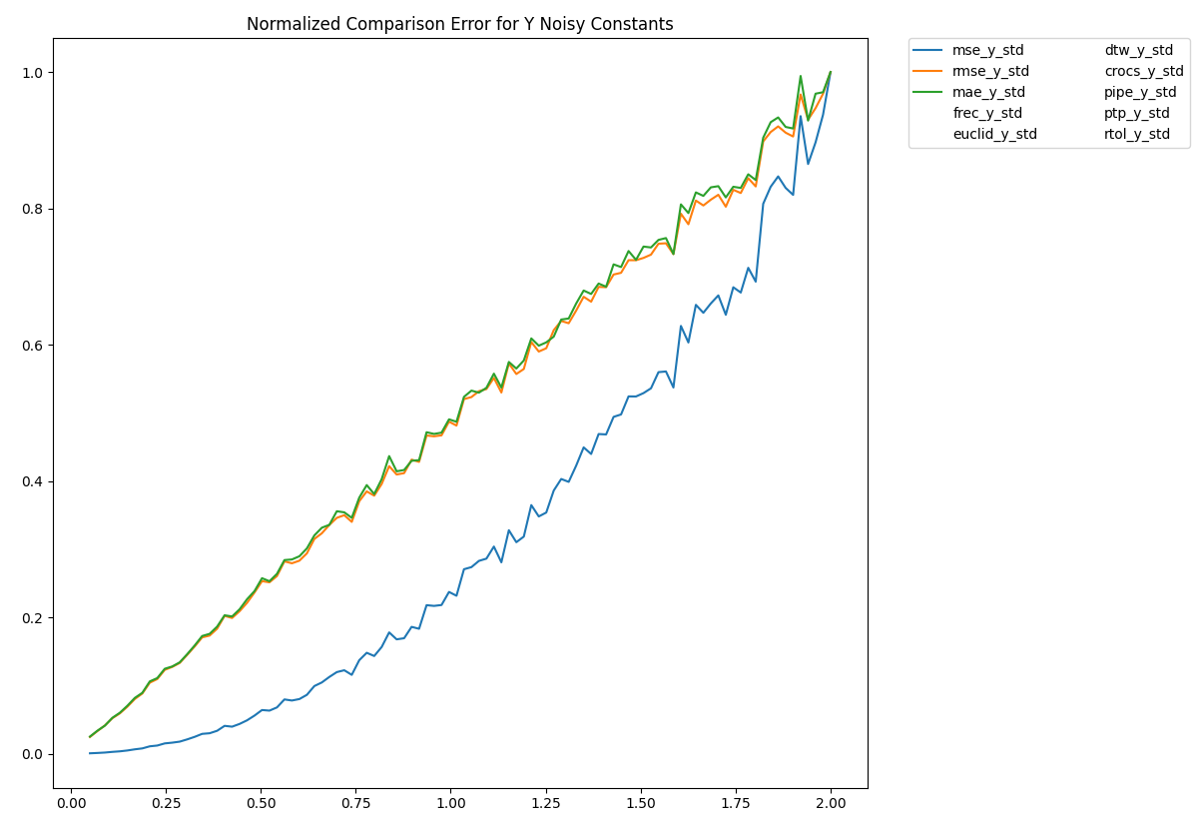
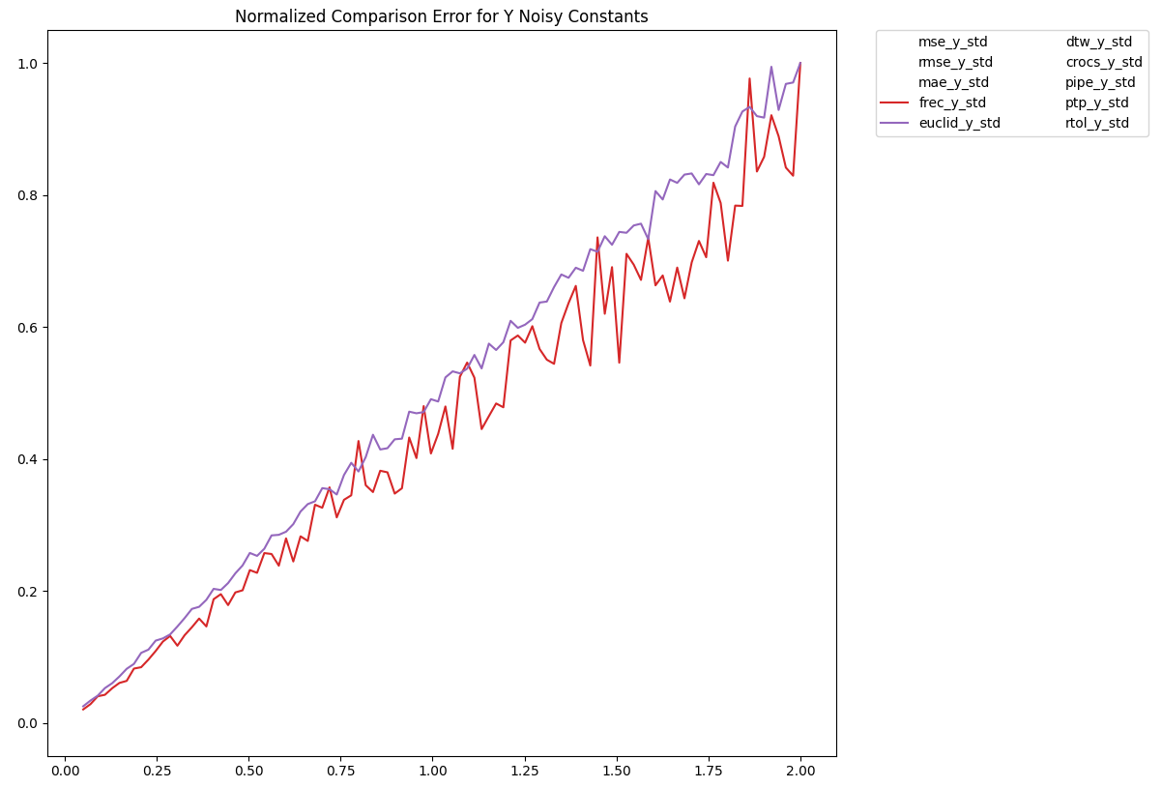
Let’s See How These Works For Simple Signals

Slide 22
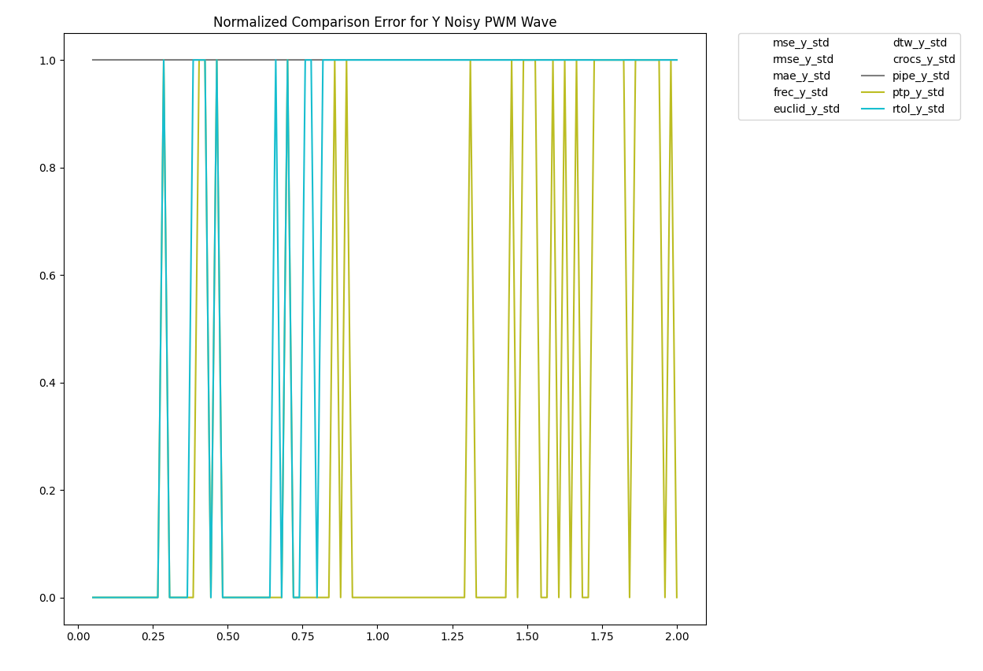
Let’s See How These Works For Simple Signals

Slide 23
Issues So Far?
Using error & distance measurements we can accurately compare simpler signals
Using Pipe we can accurately evaluate constants from PWM
But these signals cannot account for 2 key features in more complex signals
Time Invariance
Accelerations or Decelerations in time

Slide 24
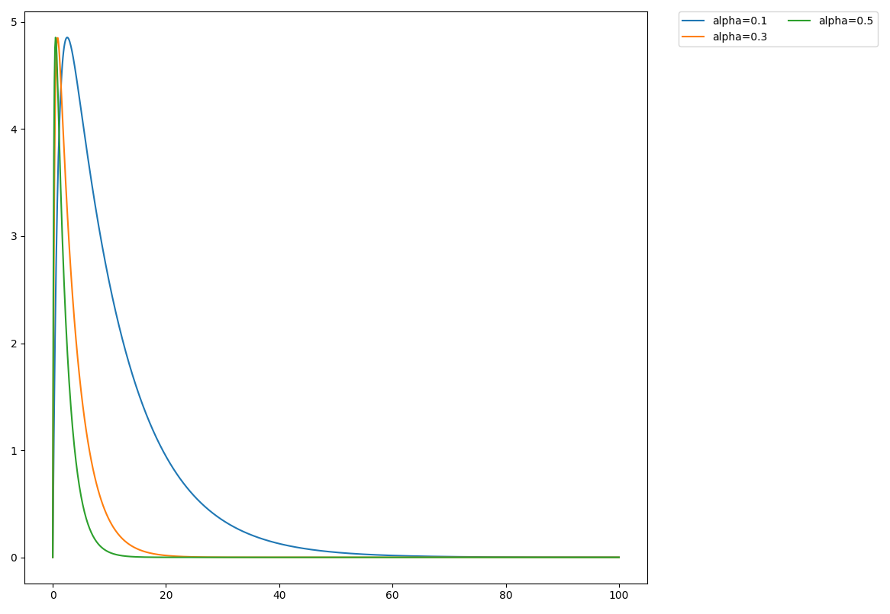
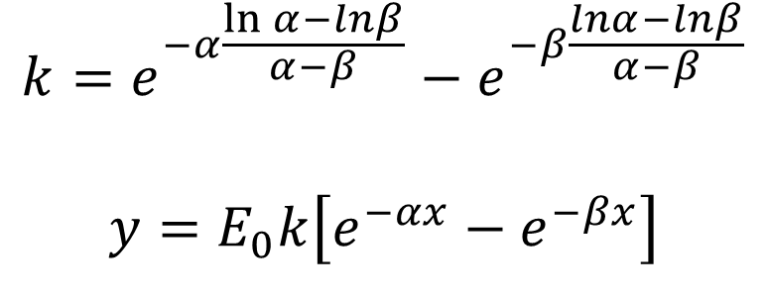
Acceleration In Time: An Example With Exponential Pulses
$$k=e^{−α\frac{\ln{α}−lnβ}{α−β}}−e^{−β\frac{lnα−lnβ}{α−β}}$$
$$y=E_{0}k\left[e^{−αx}−e^{−βx}\right]$$

Slide 25
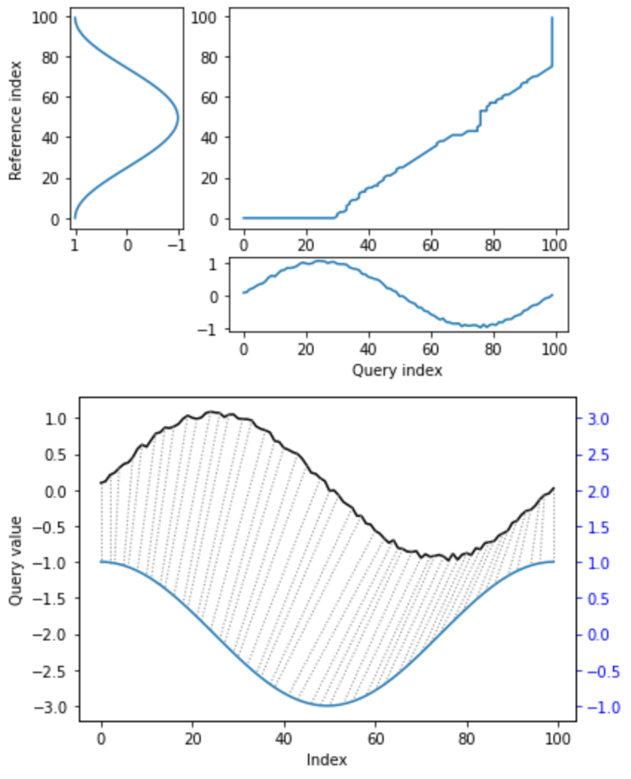
Enter Dynamic Time Warping
Every index from the first sequence must be matched with one or more indices from the other sequence, and vice versa
The first index from the first sequence must be matched with the first index from the other sequence (but it does not have to be its only match)
The last index from the first sequence must be matched with the last index from the other sequence (but it does not have to be its only match)
The mapping of the indices from the first sequence to indices from the other sequence must be monotonically increasing
https://en.wikipedia.org/wiki/Dynamic_time_warping#:~:text=In%20general%2C%20DTW%20is%20a,other%20sequence%2C%20and%20vice%20versa

Slide 26
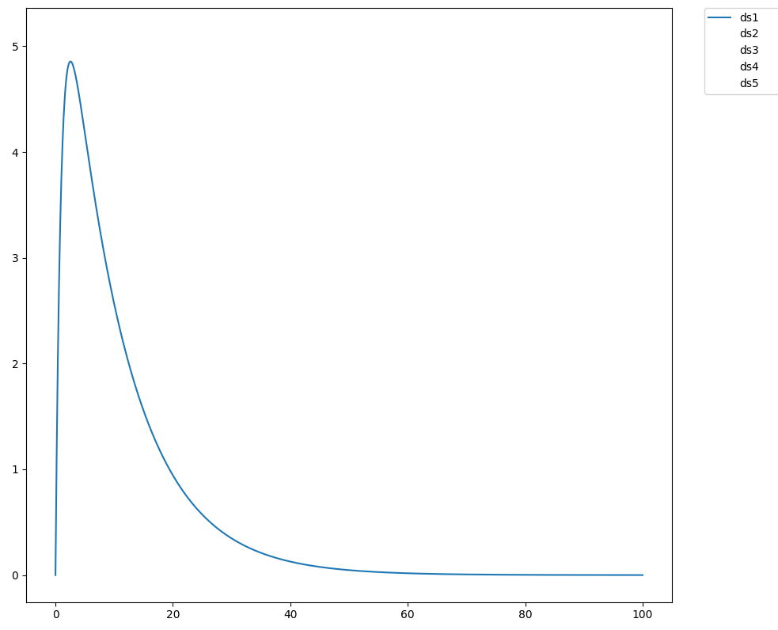
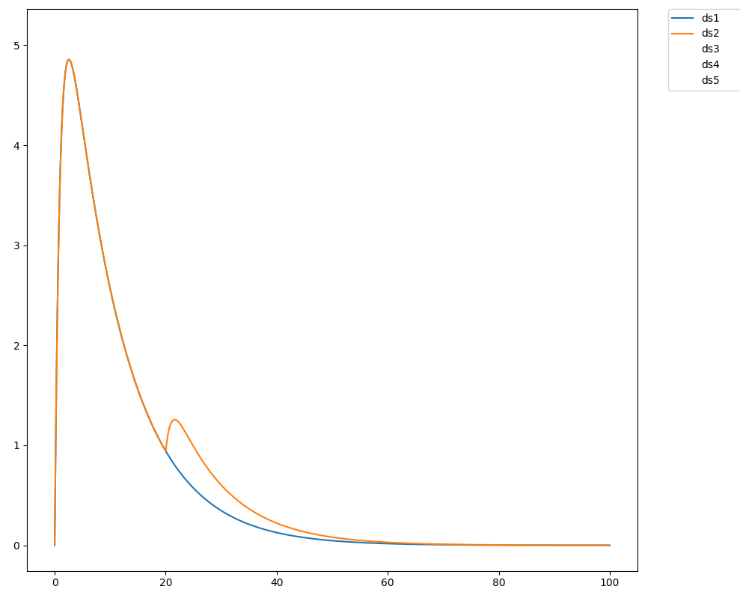
Does Dynamic Time Warping Work For Exponential Pulses?

Slide 27
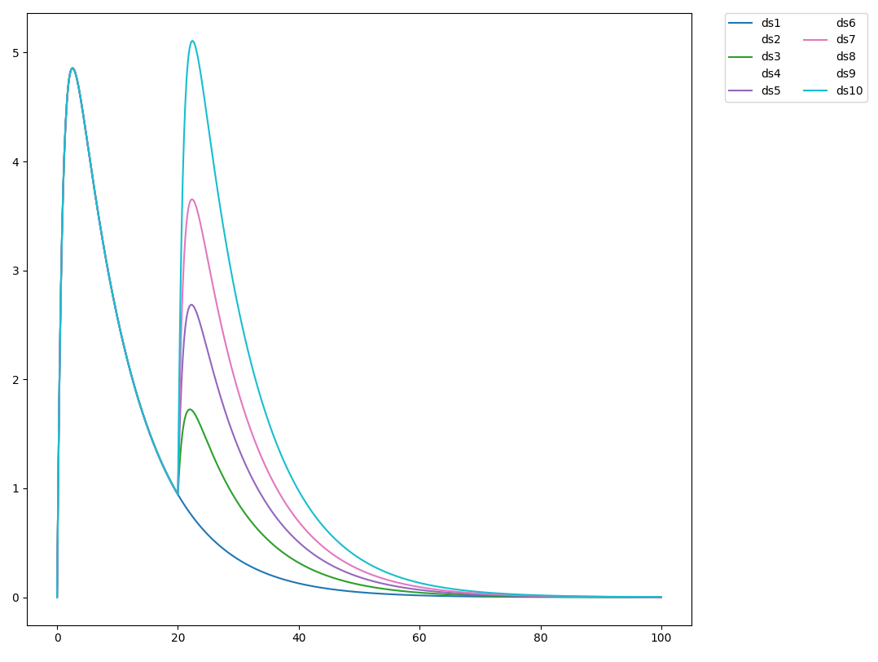
Does Dynamic Time Warping Work For Exponential Pulses?

Slide 28
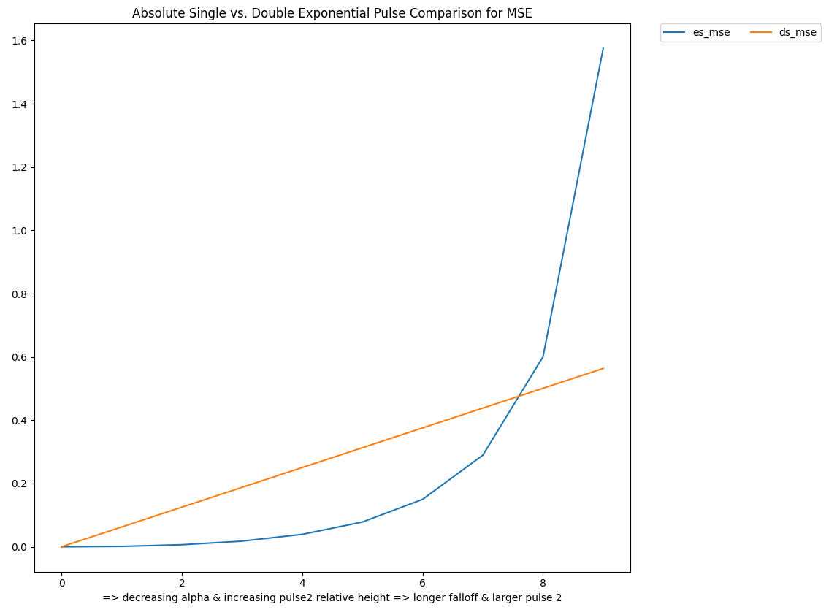
Does Dynamic Time Warping Work For Exponential Pulses?

Slide 29
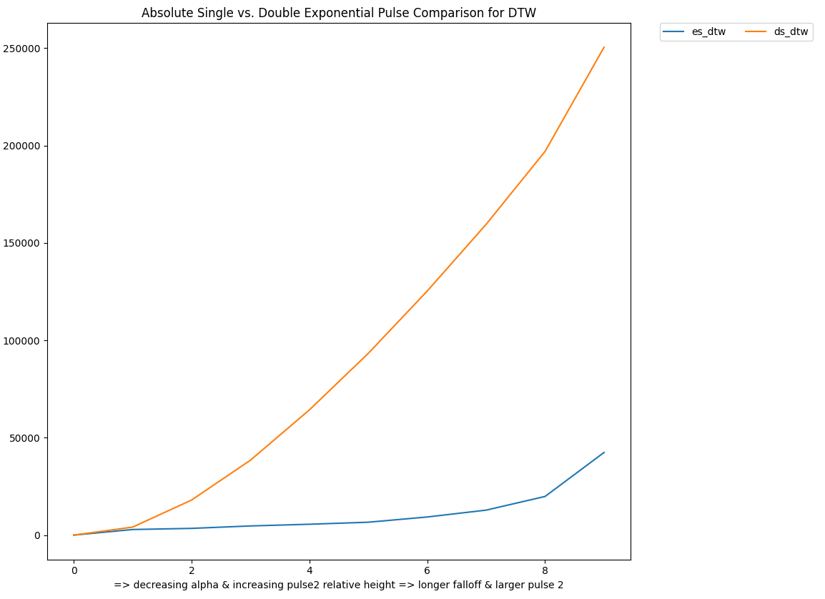
Does Dynamic Time Warping Work For Exponential Pulses?

Slide 30
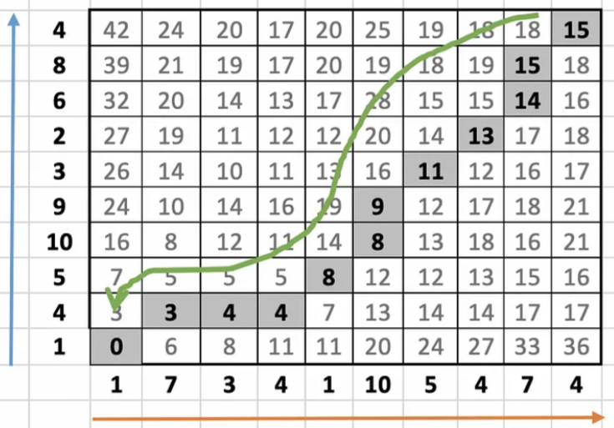
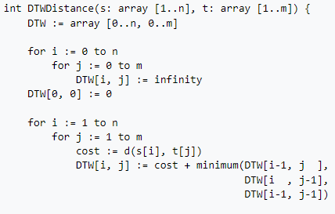
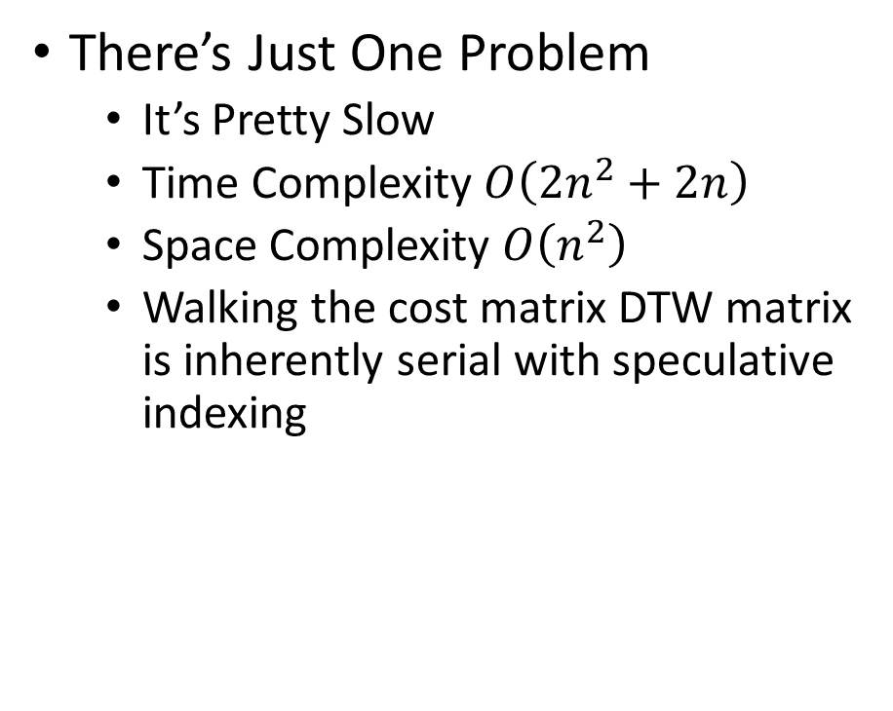
So Clearly We Need DTW
There’s Just One Problem
It’s Pretty Slow
Time Complexity $O\left({2n}^{2}+2n\right)$
Space Complexity $O\left(n^{2}\right)$
Walking the cost matrix DTW matrix is inherently serial with speculative indexing
https://medium.com/walmartglobaltech/time-series-similarity-using-dynamic-time-warping-explained-9d09119e48ec
https://en.wikipedia.org/wiki/Dynamic_time_warping#:~:text=In%20general%2C%20DTW%20is%20a,other%20sequence%2C%20and%20vice%20versa

Slide 31
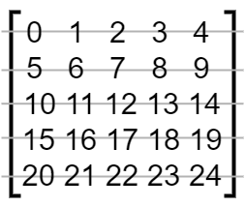
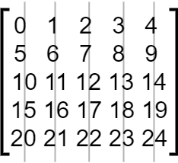
How Can We Accelerate This?
Like GEMM, the result is not dependent on the order of the loops
However, swapping the loops would only decrease cache locality
Good Cache Locality
Poor Cache Locality

Slide 32
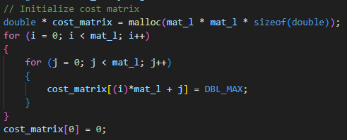
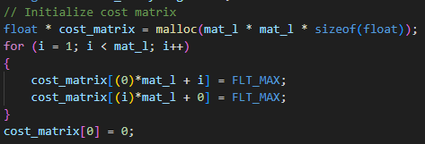

How Can We Accelerate This?
Since the DTW matrix is built by using previous values in the matrix only, we don’t need to initialize the full matrix
Reduces time complexity to: $O(n^{2}+2n)$

Slide 33
How Can We Accelerate This?
The DTW matrix does not need high-precision numbers
Since cost is based on a difference of input signals (usually 12bits on embedded systems) there’s no need for a double

Slide 34
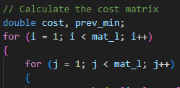
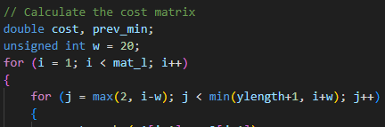

How Can We Accelerate This?
We can also Limit the maximum warping
A value at the top corner of a matrix would only be accessed if we mapped almost the entire signal to the first point in the reference
Reduces time complexity to $O(nw+2n)$

Slide 35
So How Do These Perform?

Slide 36
Theoretical Optimizations For Future Implementation
So far we’ve focused on reducing time complexity to close to linear
Now, let’s take a look at multithreading…

Slide 37
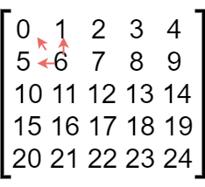
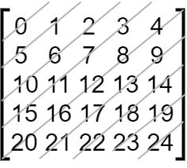
Theoretical Optimizations For Future Implementation
Elements in the DTW matrix has diagonal dependence
We could spawn threads to split data diagonally for execution
But number of threads required vary greatly throughout the matrix
Cache locality would be low

Slide 38
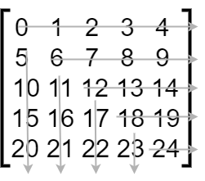
Theoretical Optimizations For Future Implementation
We could run 2 threads
One for a single row
One for a single column
Use signals to ensure data dependency at beginning of thread is met
#0
#2
#4
#6
#8
#1
#3
#5
#7

Slide 39
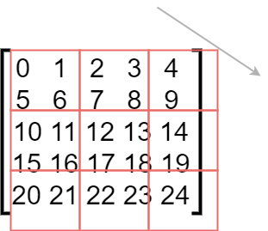
Theoretical Optimizations For Future Implementation
We could also run diagonal blocks
Store matrix in blocked order to increase cache locality
We still have large thread number variations

Slide 40
Questions?

